Slide 1
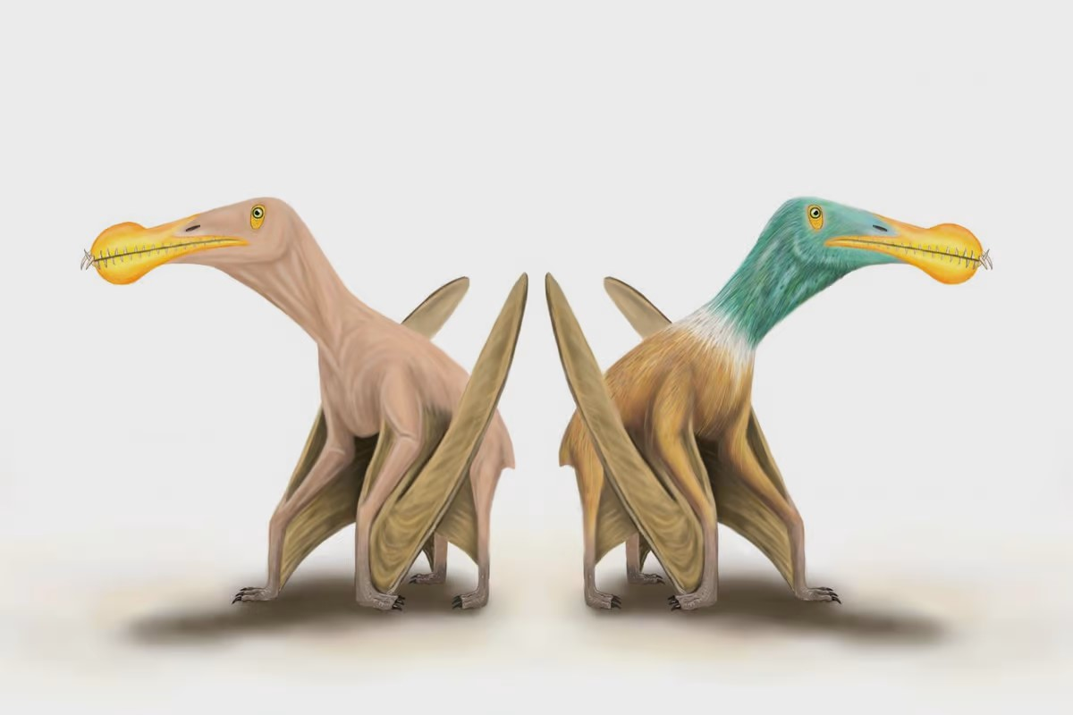
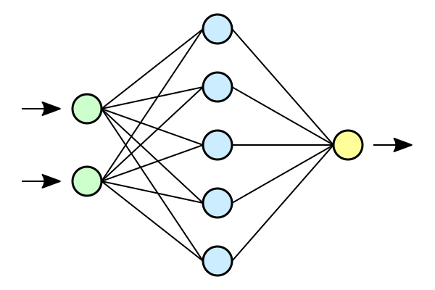
New project
+ = ???
Unique locomotion – two modes
Robot that can walk and fly would be useful
Drive and fly is easy, walk and fly has benefits

Slide 2
Methodology, steps, goal
Methodology:
Use popular RL libraries: MuJoCo, Brax, Gymnasium, Stable Baselines
Train on GPU for vastly more training (500x+ faster, 2000+ in parallel)
Steps:
Build custom model (CAD)
Setup model for simulation
Train in batches while tuning hyperparams, architecture, policy, etc.
Optimize for natural looking and reasonably fast gait
Goal / success definition:
Sim a pterosaur model walking with a reasonable-looking gait
Eventually (long after this class): build robot, get it walking, then train it to fly!

Slide 3
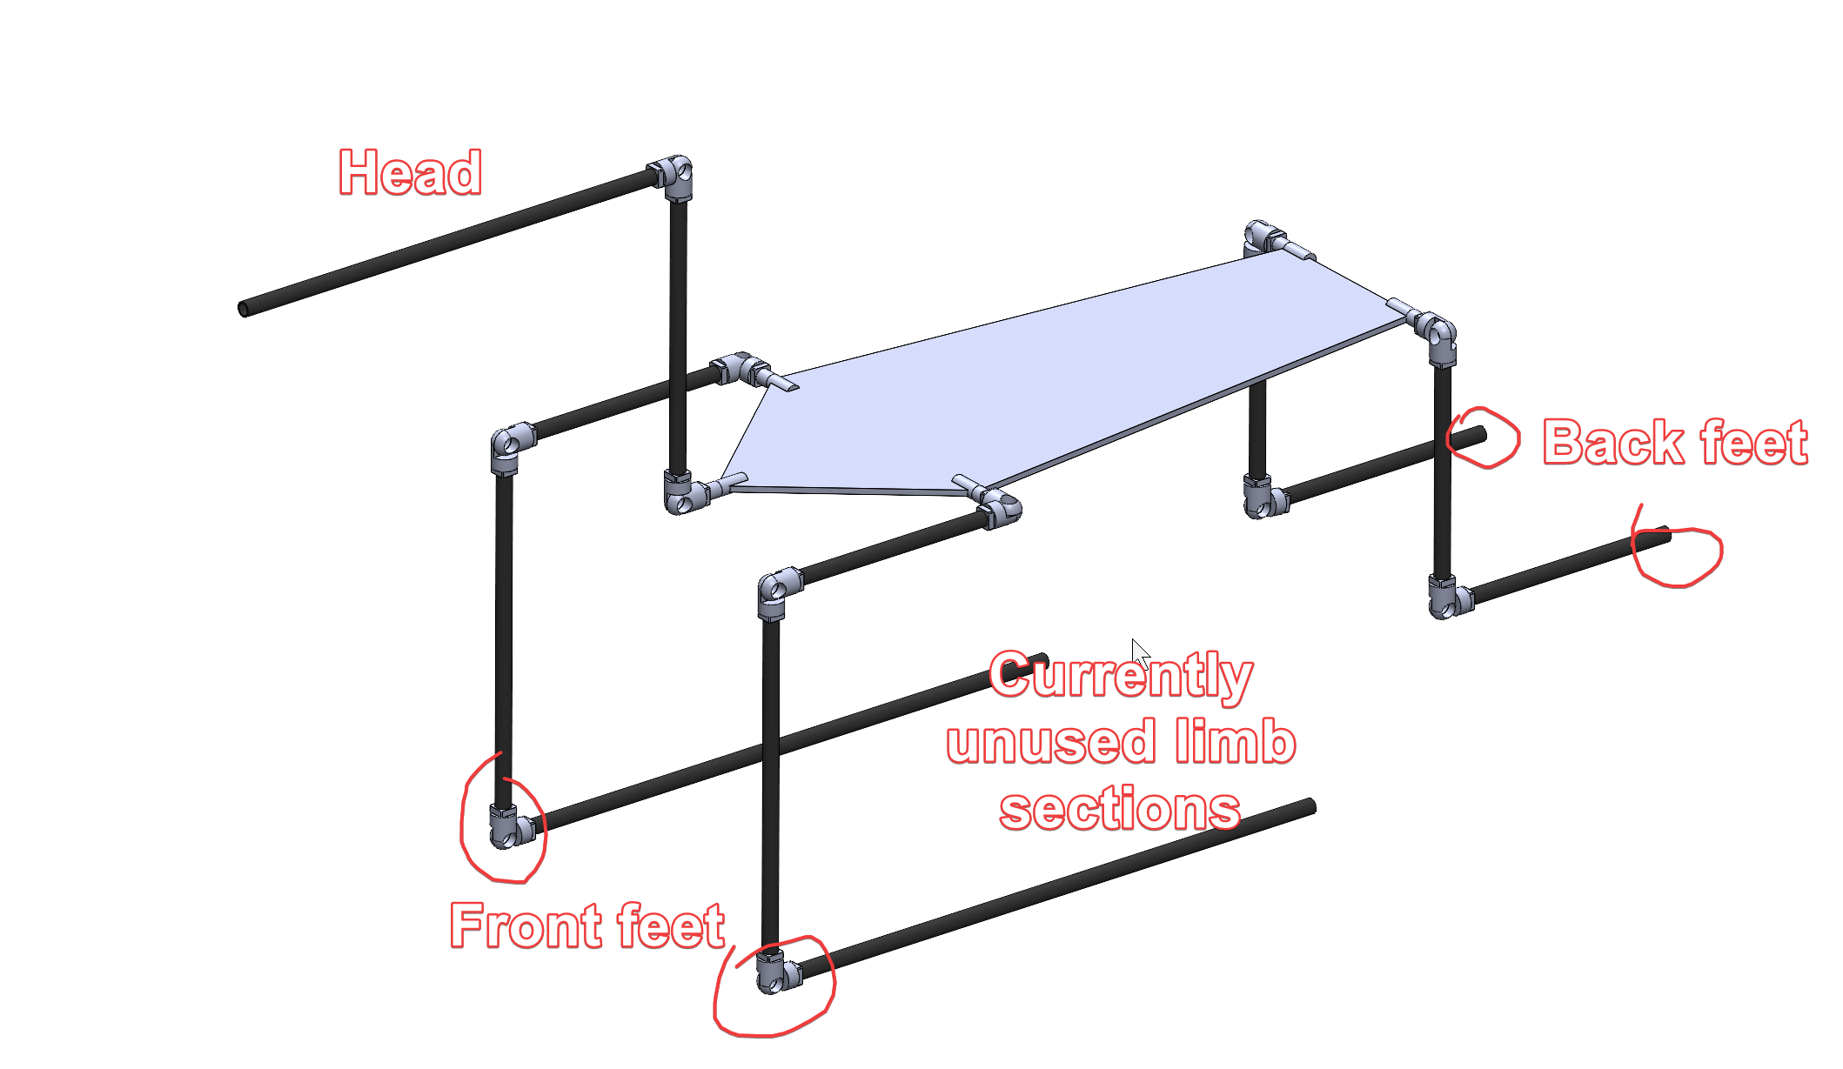
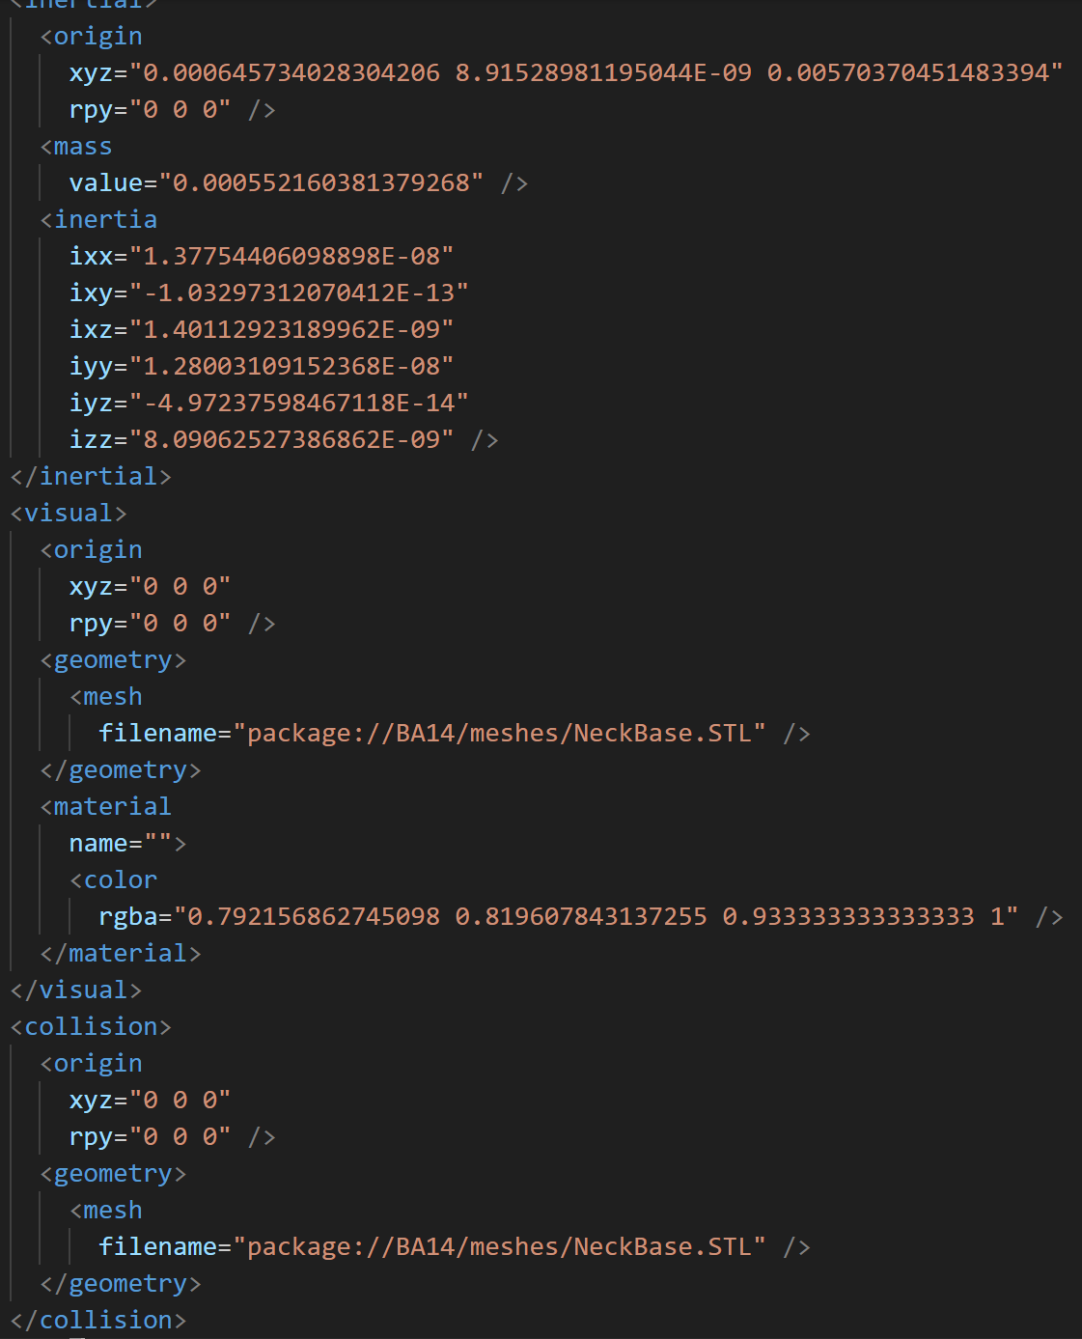
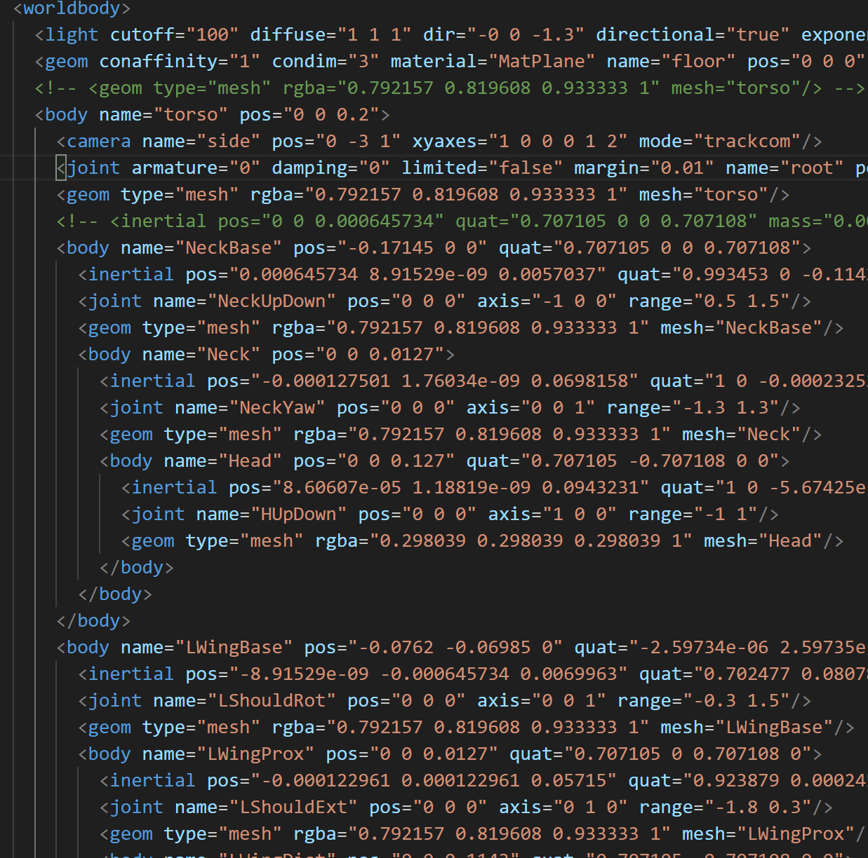
Model, URDF, MJCF
Got familiar with RL libraries through examples (MuJoCo, Gymnasium, Stable Baselines)
Modified example code: python and MJCF
→ →
+ meshes

Slide 4
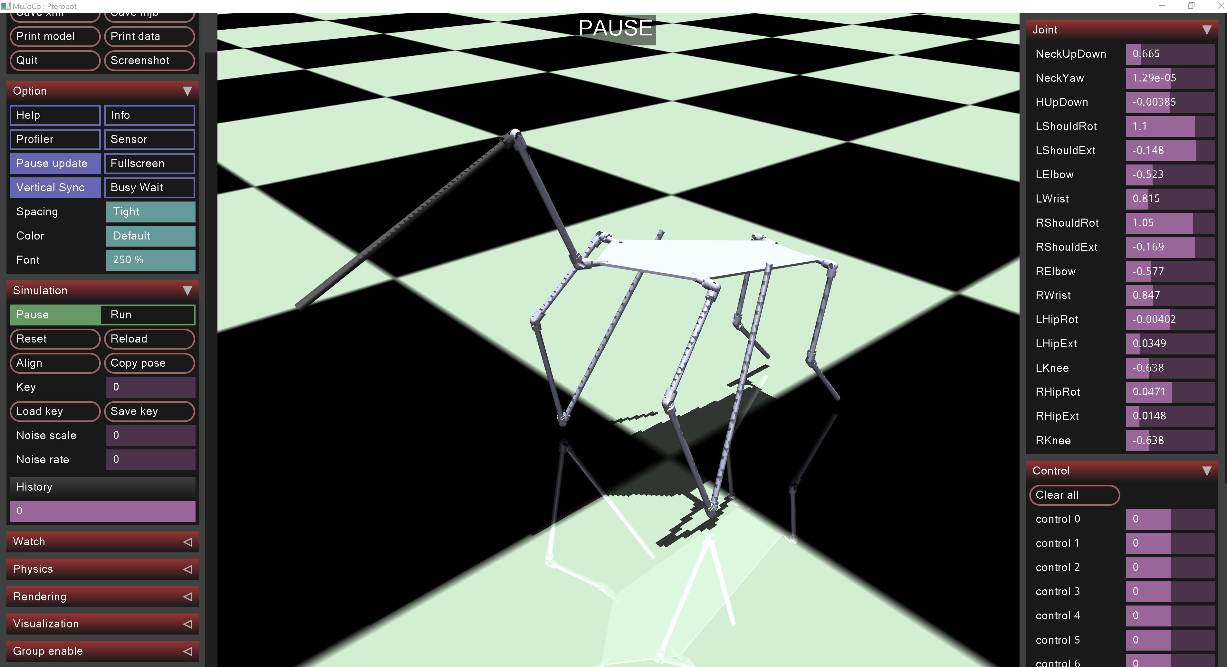
Training: Local (CPU)
Defined reward function
Set starting pose
Got more familiar with toolchain
Train!
..very slow training, no noticeable progress. Kinda just flopping around

Slide 5
Minimal training: break dancing

Slide 6
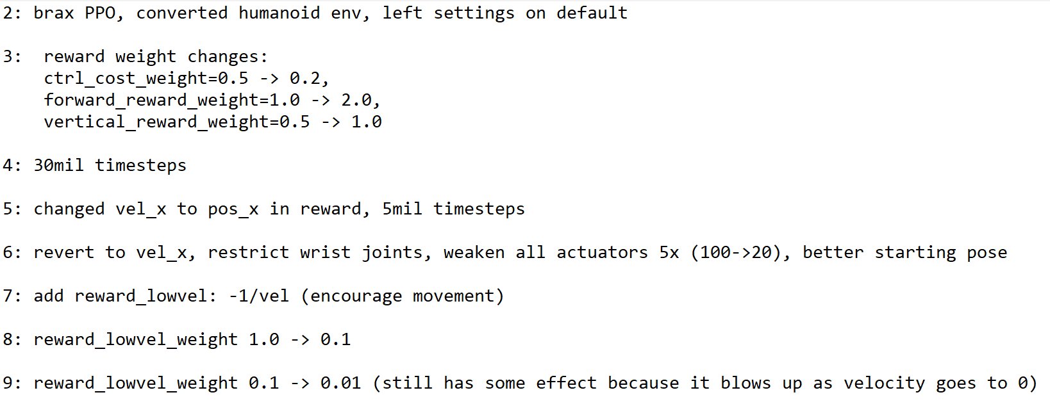
Training: Cloud (GPU)
GPU parallelization enables vastly faster training
Required library swaps because a lot of RL is still on CPU
Developed scripts to interpret policy and training (save all training data)
After WAY more training than on CPU, still no progress
Adjusted hyperparams:
Reward weights
Reward types
Restricted some joint motion (wrist)
Weakened actuators

Slide 7
Some training: Yoga!!

Slide 8
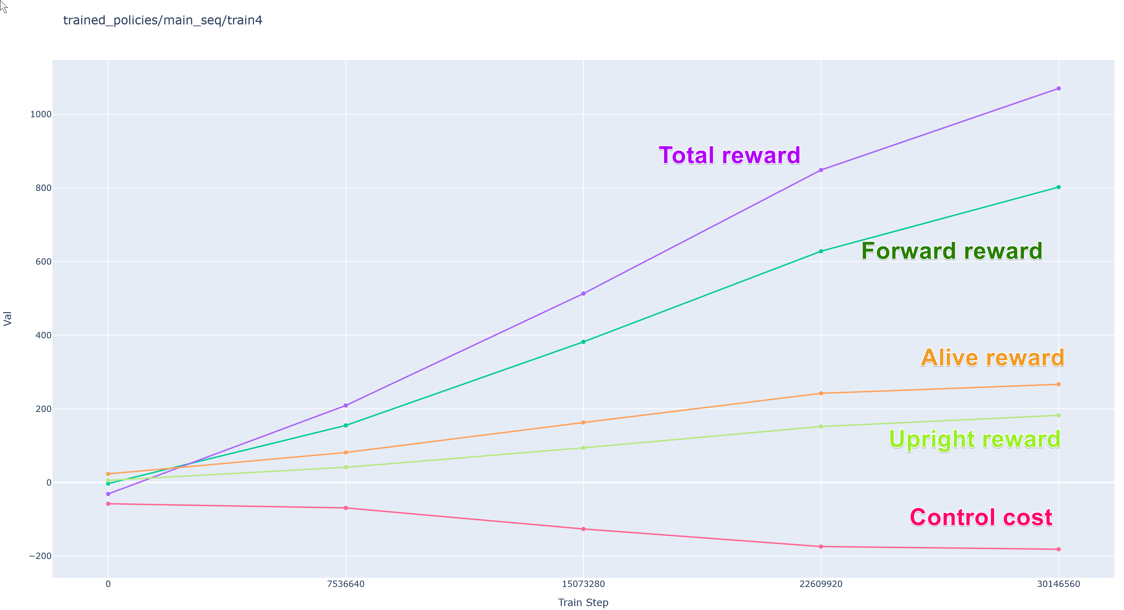
Training analysis

Slide 9
Training analysis
https://synapsomorphy.com/filehost/train2.html
https://synapsomorphy.com/filehost/train6.html
https://synapsomorphy.com/filehost/train7.html

Slide 10
Next steps
Continue tweaking reward
Continue restricting joint motion
More timesteps of training, especially if reward curves are promising
If walking soon: Evaluate different policies (Current: PPO)
Change mesh (potential for large speedup)

